Slide 1
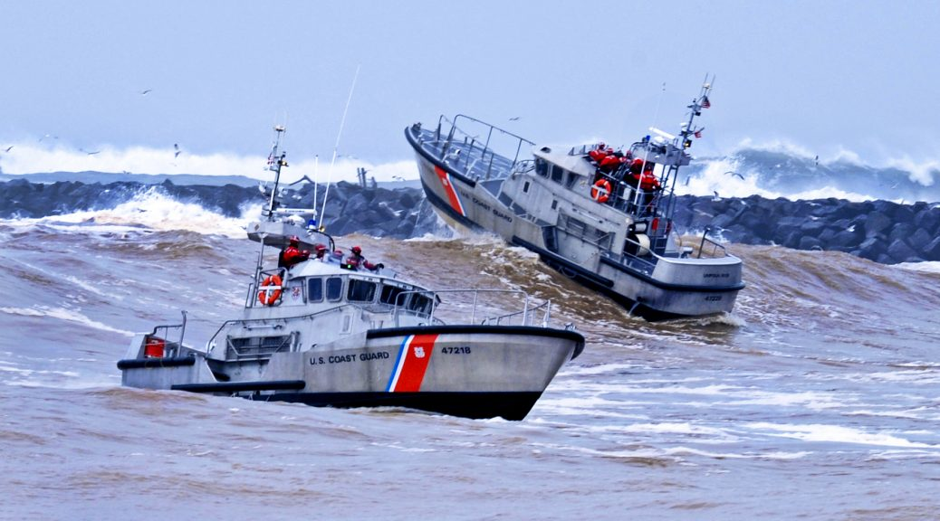

Stress & Resilience
Notes:
Stress & Resilience
You will never get rid of the stress associated with the important and critical “job” in the CG. Instead of thinking stress is bad, we need to change the way we think about stress. Stress is normal; stress is good and needed for optimal performance. Discussions should be about cultivating the mindset to embrace stress that can provide the support and energy needed to do this important job.

Slide 2
Experiential:
Mindfulness Practice
Coast Guard Operational
Stress Control (CG -0SC )
Notes:
Experiential: Mindful Practice

Slide 3


Learning Objectives
Coast Guard Operational
Stress Control (CG -0SC )
DEFINE stress and stressors and COMPARE the differences
IDENTIFY and DISCUSS stressors within the military
EXPLAIN the stress response and DISCUSS how it effects the mind & body
DISCUSS how stress is good and necessary for optimal performance
DISCUSS and DESCRIBE the difference between good stress and bad stress
DEFINE and DESCRIBE resilience
EXPLAIN the resilience continuum and IDENTIFY the importance of being resilient
IDENTIFY and DISCUSS stress resilience skills and EXPLAIN the benefits of building your resilience
Notes:
Learning Objectives
DEFINE stress and stressors and COMPARE the differences
IDENTIFY and DISCUSS stressors within the military
EXPLAIN the stress response and DISCUSS how it effects the mind & body
DISCUSS how stress is good and necessary for optimal performance
DISCUSS and DESCRIBE the difference between good stress and bad stress
DEFINE and DESCRIBE resilience
EXPLAIN the resilience continuum and IDENTIFY the importance of being resilient
IDENTIFY and DISCUSS stress resilience skills and EXPLAIN the benefits of building your resilience

Slide 4
Understanding Stress
Coast Guard Operational
Stress Control (CG -0SC )
Stress
  A state of mental or emotional strain, or tension resulting from demanding circumstances
  Associated with an individual’s perception of their ability to handle the adverse or demanding circumstances
  Can have a positive & negative affect on your mind, body, spirit & social domains
Stressors
  Any event, experience, or environmental conditions that causes stress in an individual
  These events or experiences are perceived as threats or challenges to individuals and can be physical or psychological
Notes:
Understanding Stress
Discussion Questions:
-What stresses you out?
-How do you know when your stressed?
-What is the difference between stress and a stressor?
-What are some examples of each?
-What is the purpose of stress? Are there any benefits to stress?
Stress happens to us. Stress is our body's response to a stressor. People react differently to stressors, not everyone has the same response.
Stress :
A state of mental or emotional strain, or tension resulting from demanding circumstances
Associated with an individual’s perception of their ability to handle the adverse or demanding circumstances
Can have a positive & negative affect on your mind, body, spirit & social domains
Stressors:
Any event, experience, or environmental conditions that causes stress in an individual
These events or experiences are perceived as threats or challenges to individuals and can be physical or psychological
Common stressors: basic training, field exercises, missions (deployments), trainings, inspections, work, relationships, school
Common environmental conditions: geographic location, weather, Climate- hot/cold climates, smell, noise, toxins, disease, air pollution, traffic, catastrophic events-tornadoes, wild fires, hurricanes, being in the minority

Slide 5
Stress is Necessary
Coast Guard Operational
Stress Control (CG -0SC )
Stress is essential for:
Optimal performance Strength & toughness Growth & development Developing new skills Meeting challenges Performing difficult missions
Notes:
Stress is Necessary
Discussion Questions:
-Why do you think stress is necessary?
-What is the purpose of stress?
Stress is not a bad thing. We need some levels of stress in our everyday lives. Too little or too much stress can negatively impact your performance and ability to accomplish goals.
Stress is essential for:
Strength & toughness
Growth & development
Developing new skills
Meeting challenges
Performing difficult missions
What is the purpose of stress?
It acts as a signal
It motivates us
It helps us learn
Summary:
The purpose of stress is to signal to us that something is happening that needs our attention and action.
The physical and emotional arousal and discomfort associated with the experience of stress can also motivate us to take action to resolve this discomfort.
Lastly, stress helps us to learn. As you try different strategies to cope with stress you figure out what works for you, and in what situations you can use these same strategies in the future.

Slide 6
Military Demands
Coast Guard Operational
Stress Control (CG -0SC )
Meeting the demands of the CG
Maintaining a forward presence (deployments, combat environments) Increased work demands with decreased staff Leader/management styles Career concerns Environmental conditions (climate, noise(s), & smells) Certifications, qualifications, & inspections Family adjustment, separations, & PCSing Ethical situations between doing “what is right” versus “following the rules”
Notes:
Military Demands
Discussion Questions:
-Can you think of other examples?
A career in the military is bound to be stressful, being resilient is essential for military members to survive threats and accomplish missions. Through resilience, service members will adapt well with these experiences over time.
Meeting the demands of the CG:
Maintaining a forward presence (deployments)
Increased work demands with decreased staff
Leader/management styles
Career concerns
Environmental conditions: geographic location, weather, Climate- hot/cold climates, smell, noise, toxins, disease, air pollution, traffic, catastrophic events- tornadoes, wild fires, hurricanes, being in the minority
Certifications, qualifications, & inspections
Family adjustment, separations, & PCSing
Ethical situations between doing “what is right” versus “following the rules”

Slide 7
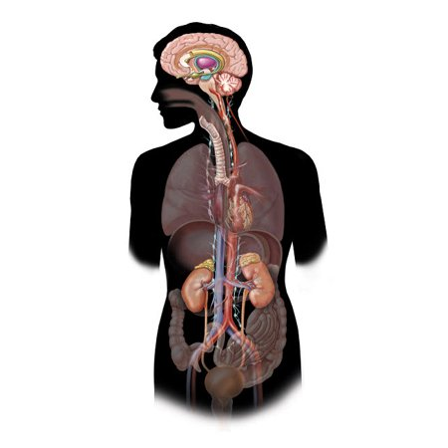
Coast Guard Operational
Stress Control (CG -0SC )
The Physiology of Stress
Notes:
The Physiology of Stress
An innate, automatic physiological (a physical change within your brain) response designed to prepare your mind and body to deal with a physical threat.
The stress response is the body’s way of protecting you. It occurs when you encounter a stressor, and when working properly, it helps you stay focused, energetic, and alert and in emergency situations, stress can save your life.

Slide 8

Coast Guard Operational
Stress Control (CG -0SC )
The Physiology of Stress
1. Amygdala
2. Hypothalamus
3. Pituitary gland
These are the parts of the brain that immediately and automatically recognize a challenge.
Notes:
The Physiology of Stress
The stress response begins in the brain. When someone confronts an oncoming threat, the eyes, ears or nose (or all) send the information to the amygdala, an area of the brain that contributes to emotional processing such as fear, anger, and pleasure. The amygdala interprets the images, sounds and smells based on memories, beliefs, expectations that are stored in the brain.
The amygdala interprets the images, sounds and smells. When danger is perceived, it instantly sends a distress signal to the hypothalamus.
The hypothalamus acts like a command center, it sends immediate nerve signals down your spinal cord to the adrenal glands (on top of your kidneys) telling them to release the hormone epinephrine (also known as adrenaline). Adrenaline is released and increases the amount of sugar in your blood.
The hypothalamus also stimulates the pituitary gland to secrete hormones like cortisol and dehydropepiandrosterone (DHEA) into the bloodstream. In the short-term, these hormones help you respond to stress.

Slide 9

The Physiology of Stress
1. Amygdala
2. Hypothalamus
3. Pituitary gland
4. Adrenal gland
Cortisol
Adrenaline
This is the automatic response of the body to enact fight, flight or freeze in addressing the challenge.
Notes:
The Physiology of Stress
The hypothalamus acts like a command center, it sends immediate nerve signals down your spinal cord to the adrenal glands (on top of your kidneys) telling them to release the hormone epinephrine (also known as adrenaline). Adrenaline is released and increases the amount of sugar in your blood.
The hypothalamus activates the second component of the stress response system- known as the HPA Axis. The Hypothalamic-Pituitary-Adrenal (HPA) Axis is a neuroendocrine system that controls the reaction to stress and regulates many body processes.
As the brain continues to perceive danger, the hypothalamus releases corticotrophin- releasing hormone (CRH), which travels to the pituitary gland (at the bottom of your brain), triggering the release of adrenocorticotropic hormone (ACTH). This hormone travels to the adrenal glands, prompting them to release a stress hormone- cortisol. Cortisol is very important in your stress response- keeping your blood sugar and blood pressure up to help you escape from danger. Too much cortisol over a long period can be bad. High cortisol can cause a number of symptoms throughout your body. General signs and symptoms of too much cortisol include:
Muscle weakness
Severe fatigue
Irritability
Difficulty concentrating
Headaches
As these hormones circulate through the body, your heart beats faster, pushing blood to the muscles, heart, and other vital organs. Pulse rates and blood pressure increases and you breathe faster pumping maximum oxygen to your muscles and brain, increasing alertness. As your body becomes ready to handle the threat (fight or flight response), your senses become keener, your memory more focused and you are less sensitive to pain.

Slide 10
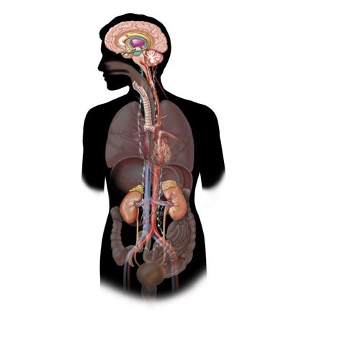
Coast Guard Operational
Stress Control (CG -0SC )
The Physiology of Stress
Mind
Focus narrows Senses sharpen Brain processes information faster
Body
Stress hormones released Blood redirected to muscles Blood pressure increases Energy is used more efficiently
The goal is to provide everyone the capacity to “fight".
Notes:
The Physiology of Stress
The effect of the stress response is widespread. Senses become sharper, muscles tighten, the heart beats faster, blood pressure rises, and breathing quickens. Although this arousal state may be adaptive in helping you cope with short-term stressors a chronic state of arousal, when no threat or challenge is present, may lead to physical and emotional health problems unless effective coping mechanisms are utilized.
The body responds the same way if you are fighting or flighting.
Mind:
Focus narrows (which is why you may experience tunnel vision)
Senses sharpen
Brain processes information faster (which is why it may seem as though the world is slowing down)
Body:
Stress hormones released
Blood redirected to muscles preparing them for action
Blood pressure increases
Energy is used more efficiently (by shutting off systems that are not necessary to deal with stress)

Slide 11
The Automatic (Autonomic) Nervous System
Coast Guard Operational
Stress Control (CG -0SC )
The Body's Automatic Response to Stress
Fight, Flight, or Freeze (Sympathetic) | Rest & Digest (Parasympathetic)
↑ Blood Pressure ↑ Heart Rate ↑ Inflammation ↑ Blood Sugar ↓ Digestion ↑ Brain Alertness | ↓ Blood Pressure ↓ Heart Rate ↓ Inflammation ↓ Blood Sugar ↑ Digestion ↓ Brain Alertness
Notes:
The Automatic (Autonomic) Nervous System
Discussion Questions:
-What does flight or fight mean to you?
-What are some examples of an appropriate time to fight?
-What are some examples or appropriate times to flight?
Several automatic processes take place in the body in response to stress, all of which help signal and motivate your mind and body to deal with the stressor. The hypothalamus regulates the Autonomic Nervous System (ANS), which is responsible for the automatic functions of the body.
The Autonomic Nervous System (ANS) includes the sympathetic nervous system (SNS) and the parasympathetic nervous system (PNS). These two systems have somewhat opposite actions:
The SNS is our “fight, flight or freeze system,” responsible for helping to ensure short-term survival by mobilizing us to respond to threats.
The PNS is our “rest and digest” or “feed and breed” system, responsible for helping us to recover from stress and engage in activities that ensure long-term survival (rest, eating, and reproduction).
The SNS activates during stress. This stimulates the release of stress hormones including adrenaline. These hormones have numerous effects on your body: increasing blood pressure, heart rate, inflammation, blood sugar, and brain alertness.
When the SNS activates, the PNS typically slows down, inhibiting processes that are not necessary in emergencies, like digestion. The good news is that the PNS is actually stronger than the SNS. There are deliberate actions you can take (e.g. deep, diaphragmatic breaths) to activate the PNS and elicit a relaxation response, that can put the brakes on the SNS.

Slide 12

Video: How to Make Stress Your Friend
Coast Guard Operational
Stress Control (CG -0SC )
Notes:
Video: How to Make Stress Your Friend
Title: How to Make Stress your friend (TED TALK)- Dr. Kelly McGonigal
Description: Dr. Kelly McGonigal argues that stress can actually be beneficial and asks you to change the way you think about stress
Source: TED talks
Link: https://www.ted.com/talks/kelly_mcgonigal_how_to_make_stress_your_friend
Time Allotted: 10 minutes
Discussion Questions:
-How have stressful experiences from the past made you stronger and more resilient today?
-How can changing your thought on stress help you deal with stress?

Slide 13
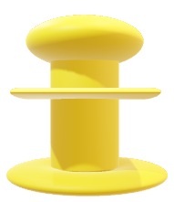



Coast Guard Operational
Stress Control (CG -0SC )
Expanded Stress Continuum
Not Engaged
Ready
Reacting
Injured
Ill
Disinterested
Unmotivated
Unfocused
No initiative
Unproductive
Lack of interest in work relationships
Good to go
Well-trained
Fit and focused
Connected
Accepting new challenges
Active coping
Quick temper
Irritable
Diminished self-control
Poor focus
Poor sleep
Pushing others away
Nausea
Temporary & transitory, needed for growth
Serious or significant distress or impairment due to: Loss, or Trauma,
Overwhelming Emotions*
Insomnia, nightmares.
Breaking relationships
Shame, guilt
Destructive behavior
Stress injuries that don’t heal without help.
Diagnosable mental health and Substance use disorders.
LEADERSHIP
OPPORTUNTIY
OPTIMAL PERFORMANCE!
(Does not mean absence of stress)
SELF-CARE OPPORTUNITY
POINT OF INTERVENTION
RECOVERS WITH EFFECTIVE CARE & REINTEGRATION
Unit Leader Responsibility
Individual, Peer, Family Responsibility
Caregiver Responsibility
Notes:
Stress Continuum Model
The Stress Continuum was developed by the CG and Marine Corps. The continuum is an evidenced-based and evidenced-informed model that is congruent with military culture. It is a spectrum of stress responses categorized into four zones which establishes a common language to identify stress responses: Green “Ready” zone, Yellow “Reacting” zone, Orange “Injury” zone and Red “Illness” zone. It is a tool and is a common language that allows us to identify, engage and intervene when stress reactions or injuries are present. This model is about asking for help and giving help.
The zones are described as:
Blue “Not Engaged” Zone
Green “Ready” zone: Wellness and adaptive coping
Yellow “Reacting” zone: Mild and reversible distress or loss of function
Orange “Injury” zone: More severe and persistent distress or loss of function
Red “Illness” zone: Medical disorders arising from stress and unhealed stress injuries
The bottom of the graph shows the overlapping responsibilities of leaders, military members, families and caregivers to force protection and conservation. The zones are described as:
Unit Leader Responsibility: The green “ready” zone indicates commands that effectively manage stress and remain resilient and functional. Effective training and good leadership are the function for building the tools needed to deal with stress effectively and results in service members who are more connected, competent and confident in facing anticipated challenges.
Individual, Peer, Family Responsibility: Units and Coasties whose resiliency is compromised fall into the yellow “reacting” zone and/or orange “injured” zone. Often times service members try to hide stress injuries from supervisors to avoid medical. This is why we are training all service members to recognize when a peer is in trouble, break the code of silence and get them connected with resources to help that individual.
Caregiver Responsibility: In the red “illness” zone members and families experience stress injury symptoms that fail to heal as expected. Symptoms in red zone indicate potentially serious illnesses that require prompt medical evaluation and treatment.
EXPANDED STRESS CONTINUUM
The Blue “Not Engaged” Zone represents an opportunity for leadership and peers to engage Service members where and when there is perpetual sub-standard performance or lack of performance altogether. Members in the Blue Zone generally seem otherwise psychologically and physically healthy. While there seems to be a lack of stress and/or stressors, and related stress injuries or illness for members in the Blue Zone, there are motives for non-engagement. The motives or factors are something tangible leaders can use to identify and start the process of mitigation or management of the non-engagement source(s) when a member is entering/has entered the Blue Zone, and for reintegration back into the Green Zone.

Slide 14
Four Sources of Non-Engagement (C O P E)
Coast Guard Operational
Stress Control (CG -0SC )
Not Engaged
Ready
Reacting
Injured
Ill
Cultivation
Organizational
Psychological
Exclusion/ Isolation
Not being challenged
Under valued
Lack of meaningful work
Lack of opportunity or being used effectively
Low level of supervisor/leadership support (lack of empathy, lack of trust)
Poor leadership & management (lack of transparency, acceptance of poor performance)
Unstable environment, Inadequate resources
Organizational Injustice
Lack of understanding of resilience and stress
A desire to remain “comfortable.”
Avoiding feelings of stress/anxiety
Disinterested
Lack of confidence to succeed
Lack of connectedness
Interpersonal conflicts have led to ostracism.
Perceived inequities
Notes:
Cultivation
Characterized by the reality or perception of a Service Member when they feel they are undervalued, unchallenged, and/or there is a lack of meaningful work and opportunity to feel like they are effectively contributing to their team/unit.
It is crucial for leaders to discern what motivates members of their teams. In doing so, leaders can start to identify both external and intrinsic motivators of individual team members, which are key to member development and the cultivation process.
Organizational
When service members choose not to engage due to organizational sources of non-engagement, while reasons may be unique, the results are similar. Where the organizational sources of non-engagement are prevalent, one may experience a lack of trust and/or empathy. This is due to the characteristics of the organizational source that feed non-engagement. Wherever there is a lack, or absence altogether, of leadership, support, and/or transparency, the potential for non-engagement increases as members may choose to create distance between themselves and the deficit of trust, support, and/or transparency. Also, when leadership declines, standards will drop, directly impacting readiness and optimal performance. The acceptance of poor performance, or, on the other end of the spectrum, micromanagement, could become the norms, further driving engagement down. Additionally, the longer organizational sources exist within a given unit; the impact can create or directly contribute to an unstable environment, inadequate resources, and organizational injustice.
Psychological
The premise of the psychological source of non-engagement is that Service Members engage or become non-engaged for self-preservation based on their psychological experience. The psychological source of non-engagement is comprised of three conditions: meaningfulness, safety, and availability.
Exclusion/Isolation
Exclusion/isolation has many potential causes and manifestations. It has significant negative impacts on teamwork, productivity, and personal wellbeing of the individual(s) excluded. In short, exclusion breeds isolation, loneliness, decreased self-esteem, psychological distress and ultimately decreased engagement.

Slide 15
Four Sources of Stress Injury
Coast Guard Operational
Stress Control (CG -0SC )
Ready
Reacting
Injured
Ill
Wear & Tear
Inner
Conflict
Loss
Life Threat
A fatigue injury
Accumulation of all stress over time
An ethical, moral, betrayal injury
Violation of deeply held beliefs
A grief injury
Loss of cherished
people or things
Serious injury
Close brush with death
Notes:
Four Sources of Stress Injury
Trauma is not the only harmful exposure. If we do not also account for loss, inner conflict, and wear and tear then leaders only listen for the metaphorical boom versus looking for the wires that lead to the explosion.
Orange-zone Stress Injuries:
Wear and Tear: Due to fatigue and accumulation of prolonged stress, including from non-operational sources, without sufficient sleep, rest, and restoration
Fatigue or prolonged stress
Can be non-operational because of insufficient sleep/rest/restore
Inner Conflict: A beliefs injury due to conflict between moral/ethical beliefs and current experiences such as taking action outside of the rules of engagement; where there is harm to an innocent life; not preventing harm to a buddy
Beliefs injury – conflict between personal ethics/morals
Unable to prevent harm to a buddy
Survivor’s guilt
Loss: Grief due to the loss of close comrades, leaders, or other cared-for individuals
Grief due to loss of a relationship
Death of close comrades, leaders, friends to family members
Life Threat: Due to traumatic life-threatening or other situations provoking terror, horror, or helplessness
Seeing someone die
Felling helpless
Traumatic life event

Slide 16
Coast Guard Operational
Stress Control (CG -0SC )
Yerkes-Dodson
Optimal Performance
HIGH
Point of Concern
PERFORMANCE
Under Performance
Impaired Performance
EUSTRESS
Burnout
LOW
Not Engaged
Distress
READY / ENGAGED
S T R E S S L E V E L
S T R E S S L E V E L
S T R E S S L E V E L
CHALLENGE
SUPPORT
Leadership / Peer Functions
Notes:
Yerkes-Dodson w/Blue Zone and Blue Zone Characteristics w/Leader Actions(in notes below)
Source: Cultivation
Discussion Questions:
-Can you think of a time when stress motivated you to perform at an optimal level? (examples: taking a test, completing a physical training)
-What is your optimal level of stress? Do you have ways of increasing or decreasing your level of stress?
We tend to think of stress in negative terms, stress however is necessary and normal in our everyday lives. Without it, we would become bored and lose interest in life. This process of experiencing mild to moderate stress and successfully coping with it typically builds resilience. Chronic stress or “prolonged” stress however, can wear us down and lead to illness.
The Yerkes–Dodson law is an empirical relationship between arousal and performance, originally developed by psychologists Robert M. Yerkes and John Dillingham Dodson in 1908. ... The process is often illustrated graphically as a bell-shaped curve which increases and then decreases with higher levels of arousal.
Stress can make you perform at your best and increase your productivity.
Eustress (Positive Stress) occurs when your level of stress is high enough to motivate you to move into action, get the job done and get things accomplished.
Stress is necessary and essential for:
Optimal performance
Performing difficult missions
Meeting challenges
Increase your productivity
Strength and toughness
Growth and development
Acquire new skills
Stress can inhibit performance when the demands of the situation exceed your perceived ability to cope.
Distress (Negative Stress)- Occurs when your level of stress is either too high or too low and your body and/or mind begins to respond negatively to the stressors
Chronic and/or Severe Stress & Burnout: Occurs with sever, frequent, or sustained stress
Stress overload can lead to:
Impaired or severely diminished performance
Lack of achievement
Persistent internal distress
Functional impairment
Misconduct
Substance abuse
Mental disorders
Characteristics
Not challenged
Under valued
Lack of meaningful work
Lack of opportunity or not used effectively
Leader Actions
‘Know Your People’ to ascertain their motivators
Fairly promote opportunity
Use failure in a safe environment to develop
Answer the ‘why?’ before it is asked (provide meaning if not readily perceived)
Incorporate realistic training and consistently provide feedback and remediation if required
Praise and reward whenever/wherever appropriate
Source: Organizational
Characteristics
Low level of supervisor/leadership support (lack of empathy, lack of trust)
Poor leadership and management (lack of transparency, acceptance of poor performance, micromanagement)
Unstable environment, inadequate resources
Organizational injustice
Leader Actions
Promote open and effective communication
Empower team members through delegation
Practice and promote Flexible Thinking*
Uphold/exceed standards
Hold members accountable for poor performance
Continual assessment of individual/team strengths/challenges
Lead with empathy
Consistently enforce standards
Plan, and incorporate feedback (lessons learned/best practices, etc.)
Attain and maintain situational/operational awareness
Address any injustice (perceived or actual) IMMEDIATELY!
Source: Psychological
Characteristics
Disinterest
A desire to remain “comfortable”
Avoiding feelings of stress/anxiety
Lack of Confidence to Succeed
Lack of Understanding of Resilience and Stress
Lack of problem solving skills
Leader Actions
Develop and implement a robust training program to include E-OSC Principles (i.e. Stress and Resilience, Problem Solving, etc.)*
Foster a safe environment where failure is a learning opportunity to evolve competence and confidence
Regularly solicit input from members to further build confidence while reinforcing value of members and their input
Incorporate and leverage Combat and Operational Stress First Aid (COSFA)* specifically, by enacting Continuous Aid (Check and Coordinate) to regularly gauge members’ potential for non-engagement
Source: Exclusion/Isolation
Characteristics
Lack of connectedness
Interpersonal conflicts have led to ostracism
Perceived inequities
Leaders Actions
Address any exclusionary practices IMMEDIATELY!
Inculcate a culture of inclusiveness and connectedness by:
Creating opportunities to team build and promote unit cohesion both in and outside of the workplace
Training members to identify and ‘call out’ exclusionary practices
Promoting Signature Behaviors
Utilizing Core Leader Functions to enable Reintegration if/when needed

Slide 17

Stress Recovery
Coast Guard Operational
Stress Control (CG -0SC )
Stress Response
stressor
stressor
stressor
Notes:
Stress Recovery
Discussion Questions:
-What is the difference between these two individuals?
When stress is well managed, arousal reaction, return to normal after the stressor is dealt with. When stress becomes overwhelming and chronic, the arousal reaction continues even after the stressors has been dealt with. In other words, the set point or baseline of arousal reactions is steadily moved upward.
Everyone has a different vulnerability to stress, which depends on many factors. Some factors are inborn and cannot be changed, while others can be modified. These factors include:
Biology and genetics
Attitude and belief towards stress
Life experiences and environmental circumstances
Psychological and physical characteristics (personality, physical fitness)
Family, social support, and community connections
Although some vulnerabilities cannot be modified (genetics and life experiences) individuals can be taught new resiliency skills that will help them become more resilient.
Other individuals are less susceptible to stress: it takes more stress for them to have a negative reaction. However, they are not immune to stress, no one is, and these individuals can still benefit from practicing coping skills.

Slide 18
Exercise:
Stress Signs
Coast Guard Operational
Stress Control (CG -0SC )
Notes:
Exercise: Stress Signs
The goal of this activity is to help participants to recognize signs of stress earlier so they can respond proactively before the stress becomes too much to handle.
Directions:
Start with a 5 minute group discussion; ask: "What stresses you out?"
Have participants review list and check signs of stress that apply to them.
Time Allotted: 10 minutes
Discussion Questions:
-How do you respond to stress?
-Did any of these signs surprise you?
-Did you check signs in each category? Or did you notice most of your signs fall into one or two categories?
-Did you notice any stress signs that you did not recognize as a stress?
Symptoms include:
Physical:
Headaches - Indigestion - Stomach aches - Sweaty palms - Sleep difficulties - Dizziness - Back pain - Tight-neck, shoulders - Racing heart - Restlessness - Tiredness - Ringing in ears
Behavioral:
Excess smoking - Compulsive gum chewing - Attitude critical of others - Bossiness - Grinding of teeth at night - Overuse of alcohol - Compulsive eating - Inability to get things done
Emotional:
Crying - Nervousness, anxiety - Boredom-no meaning to things - Loneliness - Easily upset - Overwhelming sense of pressure - Anger - Edginess (i.e., ready to explode) - Unhappiness for no reason - Feeling powerless to change things
Cognitive:
Trouble thinking clearly - Lack of creativity - Memory loss - Loss of sense of humor - Looking for magic (i.e., quick fixes) - Loss of direction - Cynicism - Apathy - Needing to “prove” self
Spiritual:
Emptiness - Loss of meaning - Doubt - Unforgiving - Martyrdom - Looking for magic - Loss of direction - Cynicism - Apathy - Needing to “prove” self
Relational:
Isolation - Intolerance - Resentment - Loneliness - Lashing out - Hiding - Clamming up

Slide 19
Consequences of Chronic Stress
Coast Guard Operational
Stress Control (CG -0SC )
Mind (Cognitively, Emotionally) | Body (Physically) | Spirit (Spirituality, Religiousness) | Social (Relationships, Social Engagement)
Memory loss Lack of interest Trouble thinking clearly Distrust Racing thoughts Loneliness/Anger Loss of motivation Nervousness & anxiousness | Crying Excess smoking Overuse of alcohol Low energy Headaches Indigestion Stomach aches Sleep difficulties | Loss of direction Loss of meaning & purpose Doubt Change in values Change in religious beliefs or spirituality | Disconnected Emptiness Unforgiving Isolation Lashing out Lack of intimacy
Notes:
Consequences of Chronic Stress
Unfortunately, when faced with prolonged periods of stress, the hormones can actually compromise the immune system causing it to wear out. Prolonged stress, the overexposure to cortisol and other stress-hormones can have an adverse effect on a service member. Stress can become problematic when is it chronic, persistent, or when it exceeds our belief in our ability to cope.
Stress becomes chronic when it:
Exceeds our belief in our ability to cope
Is unrelenting with no time for recovery
Feeds a “self-licking ice cream cone”: When you stress out about being stressed out
Mind: Memory loss - Loss of interest - Trouble thinking clearly - Distrust - Racing thoughts - Loneliness/Anger - Loss of motivation - Nervousness & anxiousness
Body: Crying - Excess smoking - Overuse of alcohol - Low energy - Headaches - Indigestion - Stomach aches - Sleep difficulties
Spirit: Loss of direction - Loss of meaning & purpose - Doubt - Change in values - Change in religious beliefs of spirituality
Social: Disconnected - Emptiness - Unforgiving - Isolation - Lashing out - Lack of intimacy

Slide 20
What is Resilience?
Coast Guard Operational
Stress Control (CG -0SC )
The capacity to withstand, recover, grow and function competently in the face of stressors, adversity and changing demands
Associated with maintaining a balanced and healthy lifestyle (mind, body, spirit, social)
Resilience can help you:
  Perform under pressure
  Increase confidence
  Overcome setbacks
  Cope with stress
  Cope with change you can not control
  Improve & eliminate barriers to optimal performance
Resilience is not a fixed trait or an inborn trait. It is something that develops and can change over time
Notes:
What is Resilience?
Discussion Questions:
-How do you define resilience? What does it mean to you?
Resilience is one's capacity to withstand, recover, grow and function competently in the face of stressors, adversity and changing demands.
The four main areas of life that can influence our resiliency include: mind, body, spirit and social domains. It is important to have and maintain a balanced and healthy lifestyle within each of these domains.
Mind: How you think and what you think about. What types of thoughts and feelings do you experience in response to stress?
Body: Your physical health. Do you get regular exercise, eat nutritious foods, get enough sleep, and take care of injuries and illnesses?
Spirit: Your values (what is important to you) and sense of purpose. How well are you able to find meaning in stressful experiences?
Social: Your connections with other people. Do you feel like you have social connections that you can turn to for support?
Resilience can help you:
Perform under pressure
Increase confidence
Overcome setbacks
Cope with stress
Cope with change you cannot control
Improve & eliminate barriers to optimal performance
Resilience is not a fixed trait or an inborn trait. It is something that develops and can change over time.
Resilience metaphor example:
Basic training/boot camp: Basic training forces recruits to find strength, and develop new skills, in an environment where resorting to old habits is severely limited. This builds confidence as recruits discover new strengths and social connections.

Slide 21
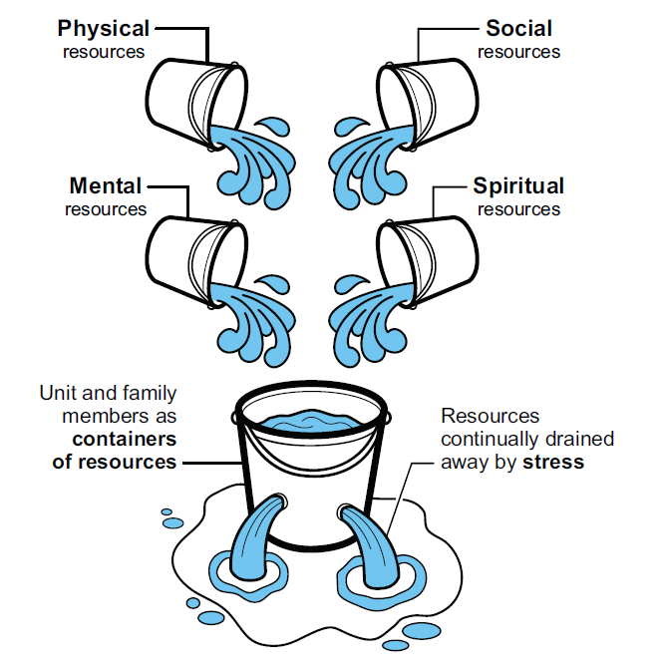
The Leaky Bucket
Coast Guard Operational
Stress Control (CG -0SC )
It is not only important to know how to replenish but when!
Notes:
The Leaky Bucket
Discussion Questions:
-What strengths do you have that help you to be resilient?
-What are some areas you could improve upon?
The "leaky bucket" is an analogy to describe the importance of self-care in the four (mind, body, spirit, social) domains through self-awareness. The bucket represents you and the holes in the bucket represent challenges and/or the effects of stress when left unmanaged. In the case of chronic stress, the bucket (you) is slowly depleted of the resources you use to remain resilient unless actively replenished through a self-care plan.
Coast Guard men and women can "run on empty" longer than most people, but no one can do it indefinitely. Like engines forced to run without lubrication, people forced to operate with too few resources are at great risk for stress injuries and illnesses.
It is important to:
Have a balance between resources in all four domains to reduce negative consequences of stress
Minimize or eliminate stressors to slow the depletion of available resources
Know how AND when to replenish these resources/domains

Slide 22
Exercise:
Domains of Resilience
Coast Guard Operational
Stress Control (CG -0SC )
Notes:
Exercise: Domains of Resilience
Improve your resiliency by identifying your strengths, limitations, and qualities you can build-on to make you even more resilient to stress.
Directions:
Step 1: Write down what you do in each domain to replenish your “leaky bucket” to build or preserve your resilience.
Step 2: What are things you can improve upon in replenishing your “leaky bucket”?
Time Allotted: 10 minutes
Discussion Questions:
-What are some of your strengths and limitations in each domain?
-Is their a limitation you would like to work on?

Slide 23
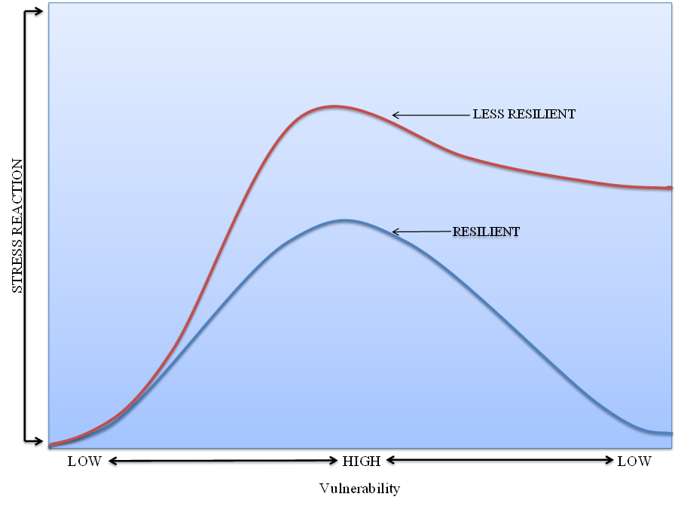
Resilience Continuum
Coast Guard Operational
Stress Control (CG -0SC )
Notes:
Resilience Continuum
Individuals have varying predispositions and vulnerabilities to stress. Individuals with lower resilience are more vulnerable to stress and have a lower threshold in responding to and managing stress. When an individual is more vulnerable, they tend to react more quickly and severely to stress. Conversely, when resilience is higher there is a decreased susceptibility to developing a reaction and a greater amount of stress is required to produce a negative reaction.
Individuals are on a continuum of resilience at any given time, based on factors or predispositions can affect their susceptibility to stress, such as:
Biology
Genetics
Life experiences
Psychological (personality) and physical characteristics (physical fitness)
Family, social support, and community connections
Environmental circumstances
Resilience is not a fixed state and can change over time. Individuals can learn new skills to strengthen resiliency for the future.
Leaders have a responsibility to mitigate or lessen the negative effects of stress and incorporate functions that physically, psychologically, socially and spiritually enhance a sailors wellbeing. They can accomplish this by removing unnecessary stressors. Mitigating stress is about the balance between strengthening individuals and reducing stressors as we train and operate. Leaders must intentionally balance stress through realistic training while reducing unnecessary stressors that are not essential to training or mission.

Slide 24
Hardiness & Resilience
Coast Guard Operational
Stress Control (CG -0SC )
Hardiness (Challenge, Control, & Commitment) is a pathway to resilience, and is what allows people to turn stressful experiences into opportunities for growth
  Challenge: A belief that stress and change is a normal part of living, and an opportunity to learn, develop, and grow in wisdom
  Control: A desire and belief in one’s own ability to have influence on the outcomes going on around you, no matter how difficult
  Commitment: A sense of purpose in life, seeing the world as interesting and meaningful. To be involved with events and people around you, no matter how stressful
Hardiness and resilience requires the adoption of coping strategies (stress resilience skills) that help individuals be engaged and work through the challenges of life.
Notes:
Hardiness & Resilience
Discussion Questions:
-What are some characteristics of resilient people you know?
-What are some of their actions that they demonstrate on a daily basis?
Evidence shows that resilience is not a fixed trait or an inborn trait. It is something that develops and can change over time (Maddi, 2006). Resilience refers to coping strategies, attitudes, and beliefs that help people work through the stress of life.
Hardiness (Kobasa, 1979), is seen as a pathway to resilience, and is what allows people to turn stressful experiences into opportunities for growth (Maddi, 2006). Her research uncovered several consistent qualities, or attitudes among people who thrived in high stress occupations. Those who seemed to cope with their stress and demonstrate resilience held certain attitudes, known as the 3 C’s: challenge, control, and commitment.
Challenge: A belief that stress is “a normal part of living, and an opportunity to learn, develop, and grow in wisdom (Maddi, 2006).” People with this attitude welcome new situations and challenges as opportunities to learn, grow, and develop on a personal level. They tend to bounce back from stress rather than letting stress negatively affect their wellbeing and performance.
Control: A desire to “continue to have influence on the outcomes going on around you, no matter how difficult this becomes (Maddi, 2006).” People with this attitude believe they can influence events and their surroundings, and can make things happen. They are also able to manage stress effectively when faced with situations that are entirely out of their control. They have a strong sense of self-empowerment, versus a sense of powerlessness and helplessness, or feeling like a victim of their circumstances.
Commitment: A belief “that it is important to remain involved with events and people around you, no matter how stressful things become (Maddi, 2006).” Commitment is having a sense of purpose in life - seeing the world as interesting and meaningful. People with this attitude are fully involved in what they are doing and give 100% to the mission. The opposite is feeling alienated from people or the environment, or a difficulty finding a sense of meaning and purpose in life.
Hardiness and building resilience requires the adoption of coping strategies (stress resilience skills) that help individuals work through the stress of life.

Slide 25


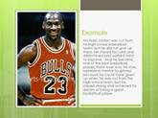

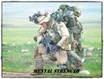
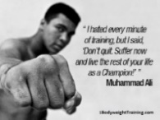
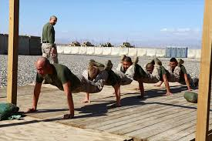

Stress Resilience Skills
Coast Guard Operational
Stress Control (CG -0SC )
Mindfulness:
  Using the mind & body to work together to help you achieve
  optimal performance under stress
  Optimize your rest and recovery
  Recognizing stress before it become a problem
Valued Living:
  Living a life consistent with your personal values can help you become more resilient to stress
Flexible Thinking:
  Can help you ACT instead of REACT
  Awareness of your thoughts, feeling, & behaviors
  Optimism, control & acceptance
Healthy Behaviors:
  Getting enough sleep
  Eating nutritious foods
  Staying physically fit & taking care of injuries & illnesses
Problem Solving:
  Building healthy coping skills, recognizing problems and breaking them down to identify potential solutions can make problems less overwhelming & reduce stress
Notes:
Stress Resilience Skills
Mindfulness:
Using the mind & body to work together to help you achieve optimal performance under stress
Optimize your rest and recovery
Recognizing stress before it becomes a problem
Valued Living:
Living a life consistent with your personal values can help you become more resilient to stress
Flexible Thinking:
Can help you respond to situations in the most effective way
Awareness of thoughts, feeling, & behaviors
Optimism, control & acceptance
Healthy Behaviors:
Getting enough sleep
Eating nutritious foods
Staying physically fit & taking care of injuries & illnesses
Problem Solving:
Building healthy coping skills, recognizing problems and breaking them down to identify potential solutions can make problems less overwhelming & reduce stress

Slide 26
Building Your Resilience
Coast Guard Operational
Stress Control (CG -0SC )
Mindfulness, values based decision-making, flexible thinking, healthy behaviors & effective problem solving, when practiced daily and regularly, these skills can help you:
Focus and perform under pressure | Promote healthy relationships
Maintain adequate control over emotions | Support mature and responsible behavior
Use good judgement | Cope with stress
Increase confidence | Solve problems
Overcome setbacks | Make good decisions
Notes:
Building Your Resilience
Mindfulness, values based decision-making, flexible thinking, healthy behaviors & problem solving, when practiced daily and regularly, these skills can help you:
Focus and perform under pressure
Maintain adequate control over emotions
Use good judgement
Overcome setbacks
Promote healthy relationships
Support mature and responsible behavior
Cope with stress
Solve problems
Make good decisions

